Slide 1
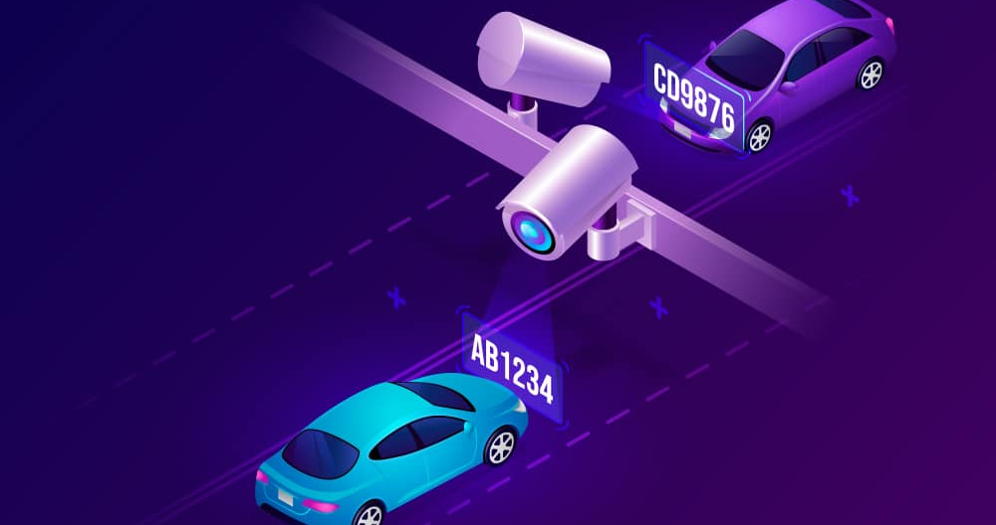
The Proposed System

Slide 2
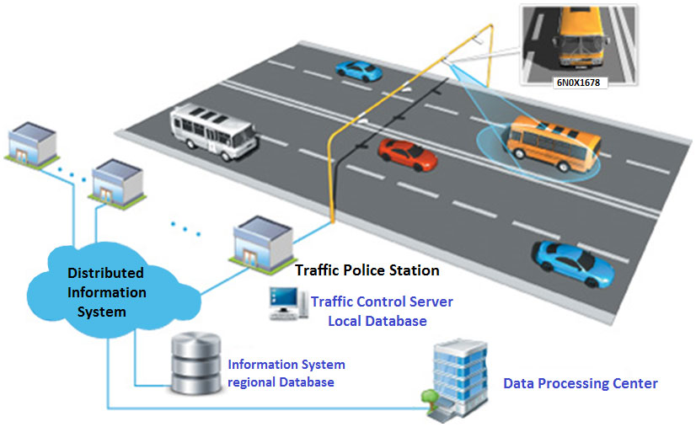
Full System

Slide 3
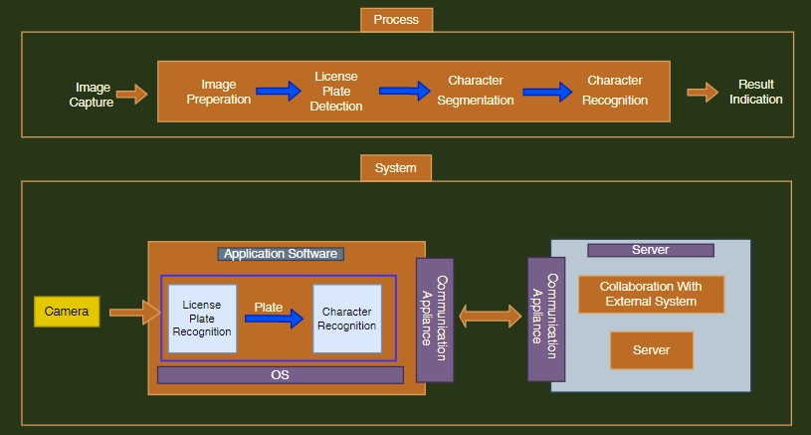
Pitch Deck Title Slide
Pitch Deck Tagline

Slide 4
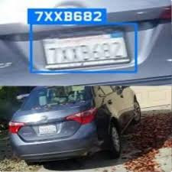



Main Phases Between Image To Result
1
2
3
Plate Detection
Character Segmentation
Character Recognition
1146
ط ر ج

Slide 5
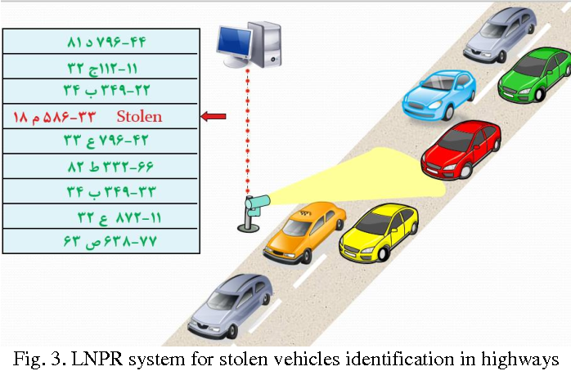
Send car image To the system

Slide 6
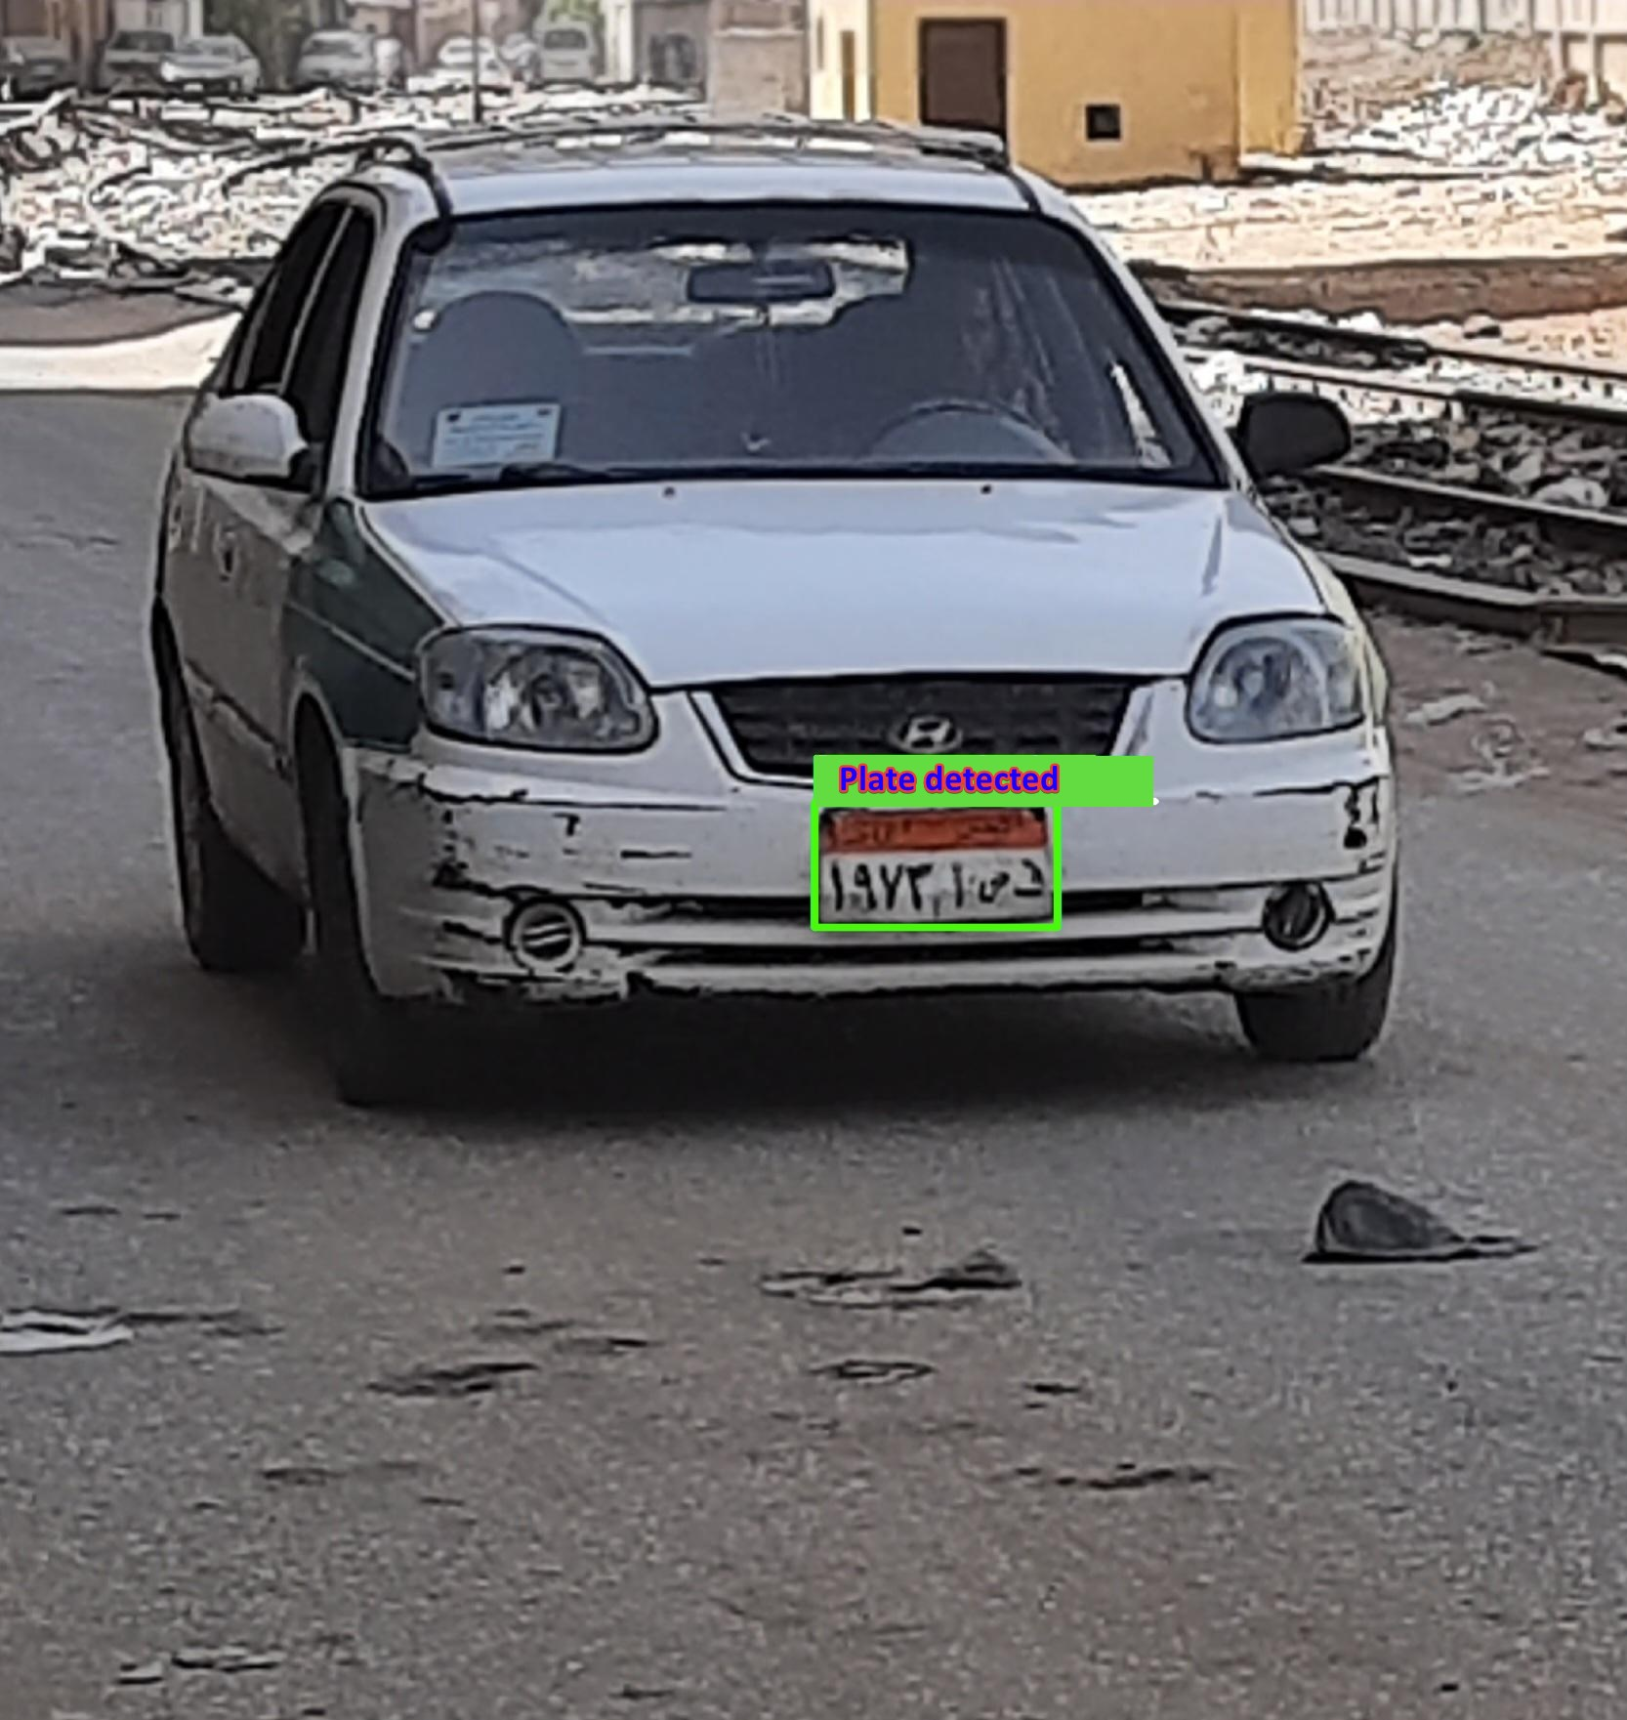
Detect The Plate

Slide 7
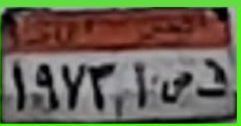

1
2
Crop Region Of Interest
Segment Characters

Slide 8
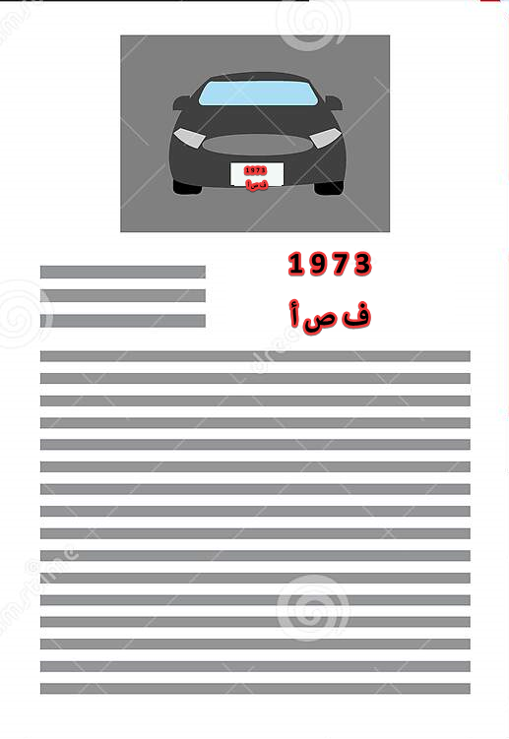
Result on the system

Slide 9
That’s Our Proposed System!
Ph:

